Slide 1


Slide 2
COVID-19 SURVEY
Food and EssentialsSSENTIALS

Slide 3
AGENDA
INTRODUCTION
PROBLEM STATEMENT & DATA SOURCE
OBJECTIVE AND METHODOLOGY
SOLUTION DESCRIPTION
IMPACTFUL INSIGHTS

Slide 4
INTRODUCTION.
THIS SURVEY HAS BEEN SPECIFICALLY CONDUCTED TO GET TO KNOW HOW OUR INDIAN POPULATION HAS SURVIVED THIS PANDAMIC.
WHICH AGE GROUPS HAVE BEEN AFFECTED AND WHICH IMMUNITY BOOSTERS HAVE BEEN TAKEN THE MOST.
HOW MANY PEOPLE HAVE BEEN VACCINATED, WHAT PEOPLE PREFER STOCKING UP AND THE MOST IMPORTANT WHAT SHORTAGE OF ESSENTIAL’S HAVE THE POPULATION FACED DURING THE PANDAMIC LOCKDOWN.

Slide 5
PROBLEM STATEMENT AND DATA SOURCE
Finding the most frequent food which is being eaten by the people during this COVID-19 pandemic and to get to know other essential needs and their availability in the market.
Data source- The data for the following analysis has been collected via google form survey.

Slide 6
OBJECTIVE AND METHODOLOGY
The objective of this analysis is to get to know our population in a better way during this pandemic and to analyze if they are facing any trouble finding any food items or other essentials in their area.
Through this analysis we can keep the local shop keepers and the people ready for the 3rd wave of covid.
This whole analysis consists of different types of graphs like bar graphs, pie charts, doughnut charts and pivot tables which make it very easy to understand.
-

Slide 7
SOLUTION DESCRIPTION
Analysing the data obtained by first organising it and then cleaning it before visualising it for further research.
Using Insight predictions, generating answers to likely survey questions.

Slide 8
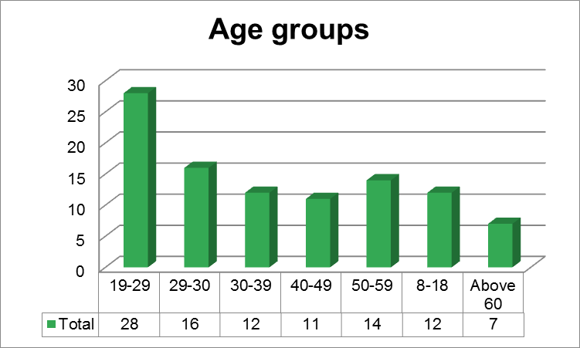
From 100 peoples data, this is the graph which shows us which age group has been the most to fill up the survey.

Slide 9
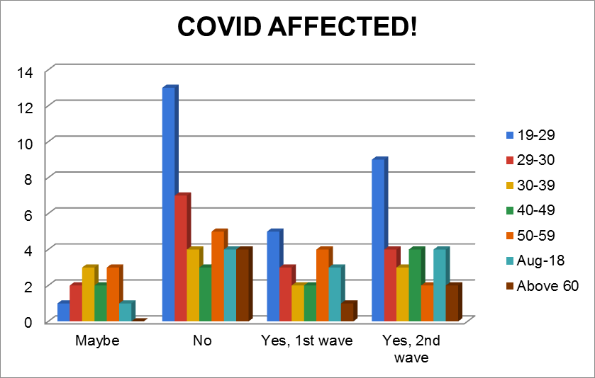
Age wise graph of Covid affected victims in the 1st and 2nd wave.

Slide 10
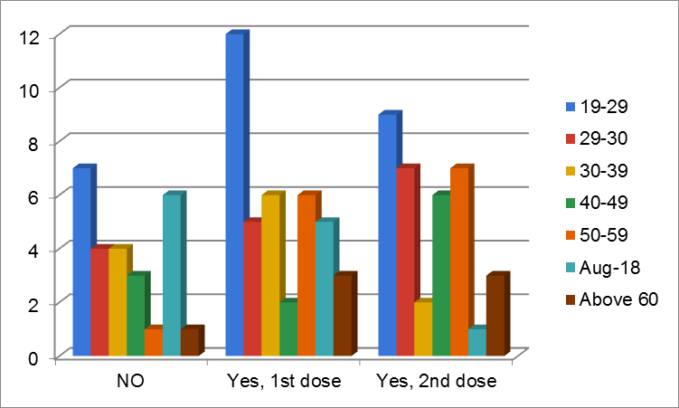
Vaccinated population according to the age group.

Slide 11
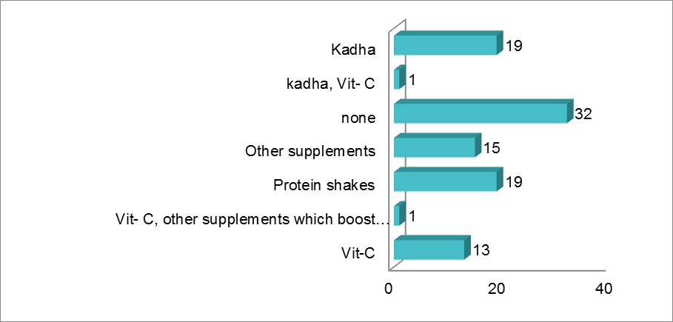
Immunity boosters taken and preferred by the people

Slide 12
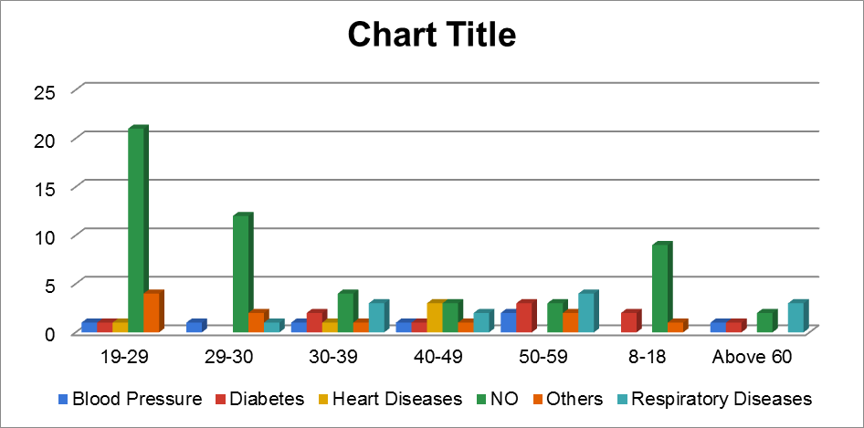
Graphical representation of other health issues, age wise which can’t be neglected.

Slide 13
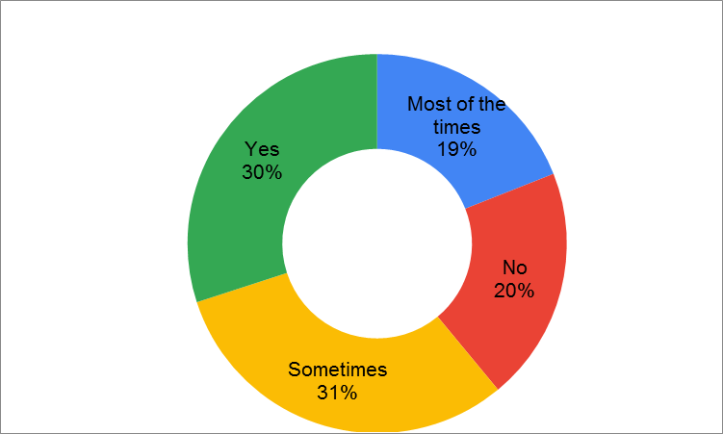
According to the survey when asked “Do you follow any kind of diet?” this is the answer

Slide 14

People who order food from outside/online

Slide 15
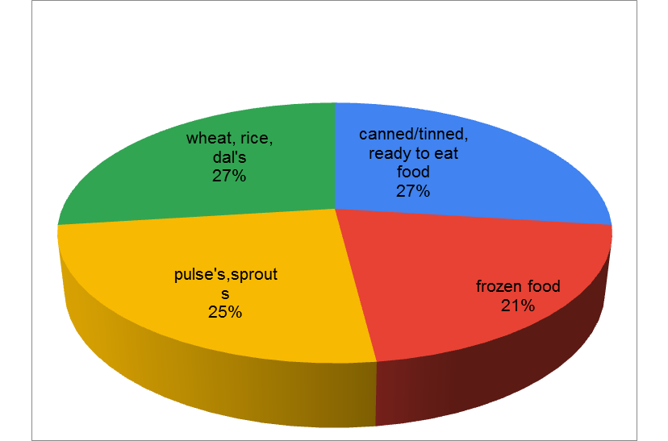
What the people stored up and will store up if there is total lockdown announced again in the future.

Slide 16
Following is the graph that shows what are the other essential items and services people have faced inconvenience with in the past Lockdown’s. These items and services should be provided and taken care of in the future.

Slide 17
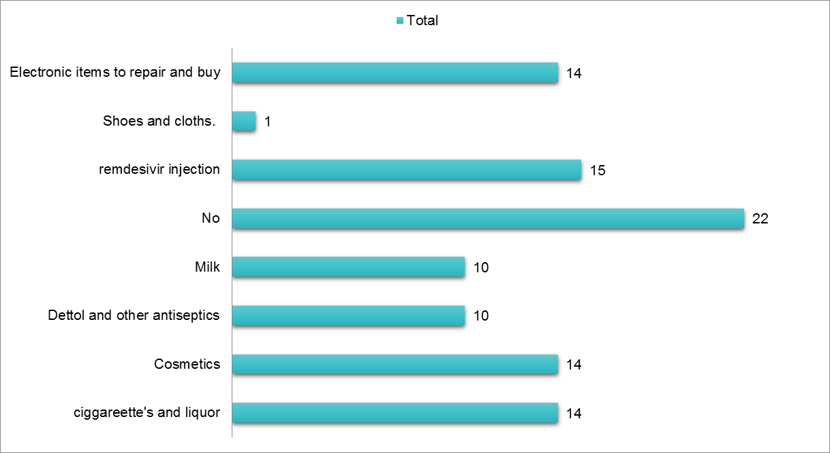

Slide 18
IMPACTFUL INSIGHTS
In comparison to the first wave, the second wave affected more young and middle-aged people because the lockdown was lax and many locations such as cafes, bars, and restaurants were open.
A large number of people are still waiting to be vaccinated.
The majority of people do not take any immunity boosters, but those who do prefer kadha, followed by protein drinks, vitamin C, and other supplements.
Since Covid strickedd, we have been ignoring other health conditions that are and can be just as hazardous as Covid if neglected.

Slide 19
IMPACTFUL INSIGHTS (CONT.)
Since Covid strickedd, we have been ignoring other health conditions that are and can be just as hazardous as Covid if neglected.
One beneficial effect is that people have begun to eat healthier and adhere to a healthy diet plan as a result of covid.
According to the survey, the majority of consumers order food online or from a restaurant, with only 20% not doing so.

Slide 20
IMPACTFUL INSIGHTS (CONT.)
Practically all types of food and food grains were kept, and the survey indicates that people will store almost all types of food if a future lockdown is announced, but wheat, rice, dal's, sprouts, and ready-to-eat foods are the most desired.
During previous lockdowns, individuals had challenges with other vital items and services, such as a shortage of remdesivir injection, which was (is) resolved, and cigarettes and liquor were sold in black and were extremely expensive. Many addicts and their families suffered emotional and physical consequences as a result. The availability of electronic devices and services was constricted. Dettol and comparable antiseptic items, as well as cosmetics, were in low supply during the initial lockdown.

